Slide 1
Stock market prediction

Slide 2
Proposed model
Everyday the model will scrape the data from the star online and input it into a csv file.
Next, we will do some data prepossessing to prepare the data to be fitted into the machine learning model.
The model will be used to generate a signal to indicate whether to buy the stock or not.

Slide 3
Machine learning model
Feature engineering: features generated based on some of the technical indicator that can be obtained from TA-Lib packages.
Example of technical indicator:
Momentum based: ADX, APO, CCI.
Volume based: OBV, ADOSC
Volatility based: ATR
A tag (0,1,2,3) was generated based on the percentage change of the next 2 days price. The tag was used as the target for the model training. For example, 3 indicate more than 3% increase in next 2 days.

Slide 4
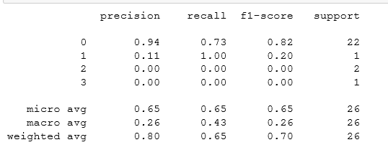
Result

